Slide 1
Dynamics of Platforms

Slide 2
Introduction
Last time: introduced basic ideas about platforms, network effects, competition and platform pricing.
Today: some case studies of platform competition and evolution to highlight:
  Adoption and platform growth
  Platform competition: tipping and co-existence
  Maturation of platforms & user life-cycle patterns
Focus on selected examples: mostly pictures!

Slide 3
Adoption and Growth
Is there a typical pattern through which new products or technologies are adopted?
Classic study in economics is Zvi Griliches’ Ph.D. dissertation on the spread of hybrid corn, which introduced several useful ideas:
  Logistic pattern of adoption
  Network spread of technology

Slide 4
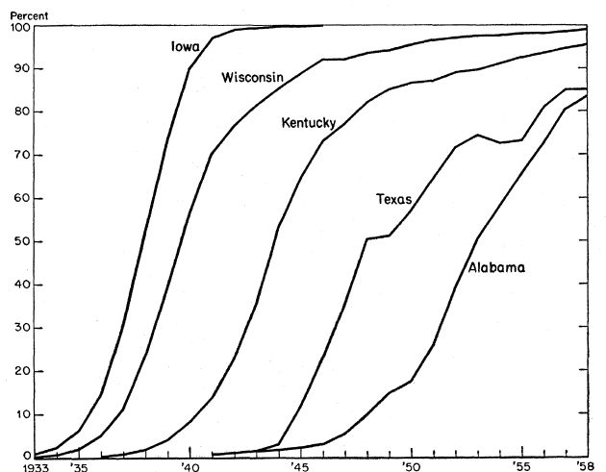
The Griliches “S-Curve”
Percentage of corn acreage planted to hybrid seed, from Griliches (1957, 1960).

Slide 5
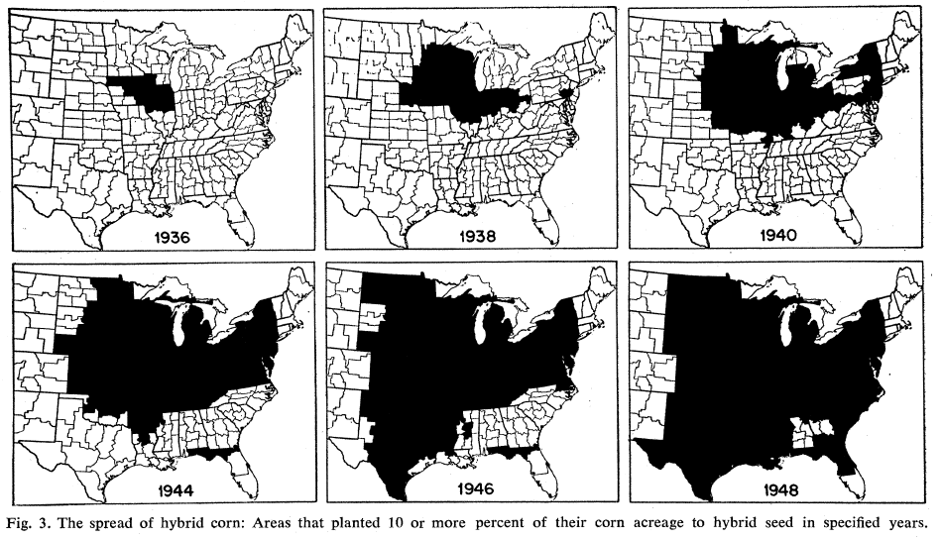
Spread of Hybrid Corn

Slide 6
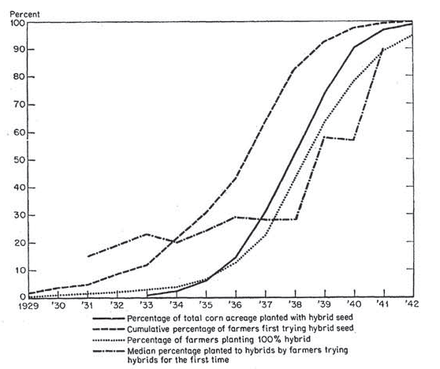
The Griliches “S-Curve”
Percentage of corn acreage planted to hybrid seed, from Griliches (1957, 1960).

Slide 7
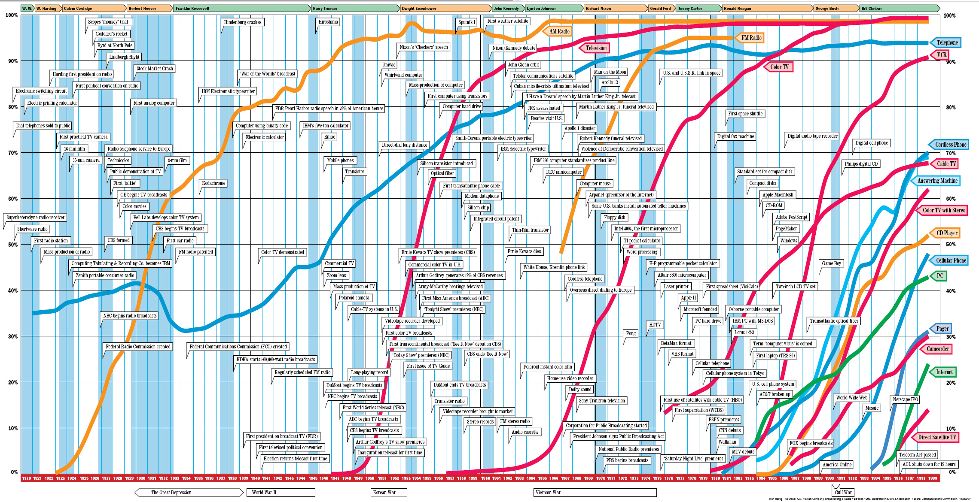
Technology Adoption Curves

Slide 8
Winner-Take-All?
In the presence of relatively strong network effects, we argued last time that one may expect a single platform or marketplace to emerge as dominant.
Not always the case
  Christies and Sotheby’s in auction markets
  NYSE and NASDAQ in public equities
  Craigslist and eBay in consumer-consumer selling
Can we say more about when, why and how competition between platforms “tips”?

Slide 9
Tipping in Online Auctions
Online auctions as an example
  Many early entrants to online consumer auctions.
  Yet most countries tipped: by 2001, eBay had 65% US market share, and dominated in Europe.
  Yahoo! exited Europe in 2002, US in 2007, but quickly established a dominant position in Japan.
Why couldn’t two markets reach sufficient scale?
  Could imagine “co-existence” if sellers and buyers anticipate similar opportunities and prices in both markets (Brown-Morgan experiment to test).

Slide 10
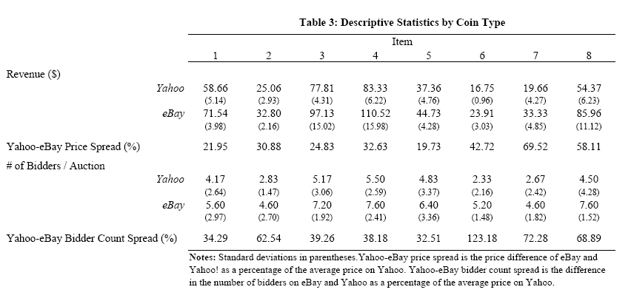
Tipping in Online Auctions
Brown-Morgan (2009, JPE) sale of coins on eBay and Yahoo! in 2004.

Slide 11
Co-existing marketplaces
Of course, platforms did end up “co-existing” with eBay, but were differentiated in various ways.
  Amazon: more limited set of “standardized” products, smaller set of reputable sellers, posted prices, Amazon often manages shipping and order fulfillment.
  Craigslist: extremely low cost of posting something for sale, no fees, generally local so no need to ship things you sell.
  Specialized “vertical” e-commerce sites like Etsy and One Kings Lane focus on a particular category of goods, and sites are designed specifically with these products in mind.
Model from last time suggested that differentiation (and “multi-homing”) would work in favor of co-existence.

Slide 12
Communication Networks
Early telephone networks present a clear example of the power of network effects.
History of local telephone competition
  AT&T builds first networks, enjoys patent protection.
  In 1893, patent expires, “independents” enter into uncontested rural markets, then challenge AT&T in cities.
  From 1893-1910s, telephone grows rapidly, and independents obtain 50% market share.
  By the 1920s, however, AT&T becomes completely dominant and remains so until break-up in 1982.

Slide 13
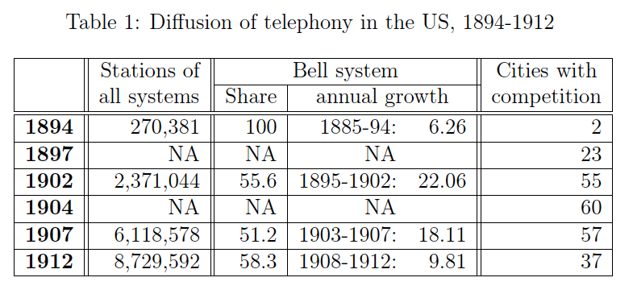
Bell versus Competitors
From Markus Mobius (2001): “Death Through Success: The Rise and Fall of Local Service Competition at the Turn of the Century

Slide 14
Local and Global Network Effects
AT&T and independents adopted different strategies.
  AT&T developed its network with the aim of national interconnection: investment in “long lines”, uniform and high standards for local networks.
  Independents focused on local interconnection, less investment in long lines, inter-city calls.
Nature of network effects
  Most phone calls (50-75%) are social, and most calls by a given household are to a relatively limited set of households.
  From 1902-1912, 97% of calls were local, but over time the demand for inter-city calls increased, giving AT&T an advantage that helped the market to tip (Mobius, 2001).

Slide 15
Social Networks
Several plausible early entrants
  Friendster, MySpace, Orkut, Facebook, etc.
  Even focusing on colleges, Facebook was adopted at some but not all, and more generally was way behind MySpace in users. (Link)
Why did market tip toward Facebook?
  Better intrinsic experience (eg clean design)?
  More “desirable” set of users (exclusivity)?
  Cross-college network effects (Bell analogy)?

Slide 16

Paul Butler’s Facebook Map

Slide 17
Entry and Dominant Platforms
Network effects can make it hard to directly compete with a dominant platform. When can there be successful entry?
  “Niche” entry: picks off specialized users or sub-market.
  Disruptive entry might come in from a different angle.
  Disruptive entry can follow a technological shift.
Examples?
Consider as a case study the evolution of financial markets for public equities after introduction of electronic trading.

Slide 18
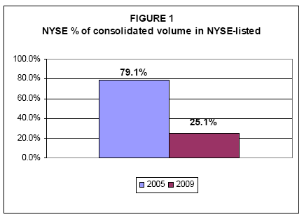
Financial Exchanges
SEC Concept Release on Market Structure, 2010

Slide 19
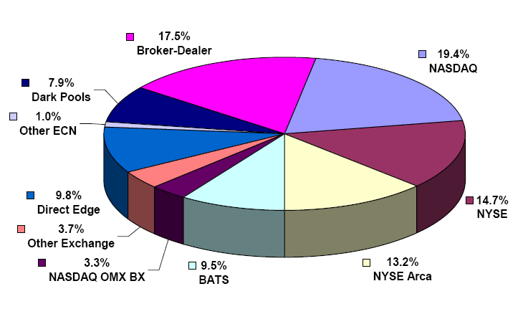
Financial Exchanges
Current fragmented market structure in trading of public equities

Slide 20
Financial Exchanges
Electronic marketplaces facilitate
  Faster, smaller, larger number of trades
  New entry and fragmented market structure
Should we expect/hope for market to “tip”?
  Competing: lower fees, more innovation
  Consolidated: better coordination, matching of offers.
In this setting, regulatory decisions can have substantial effect, e.g. force orders to be displayed in all markets, etc.

Slide 21
Maturation of Platforms
S-curve logic suggests user base and usage eventually will reach saturation or growth limit.
Platform users exit as well as join
  Should really think of user growth as having more adopters than exiters; subsequently this may reverse.
Questions
  Can we identify patterns of how platforms/markets change as they mature?
  Which users persist and become more active (early adopters, late adopters?), and which users exit?
Two case studies: Wikipedia and eBay.

Slide 22
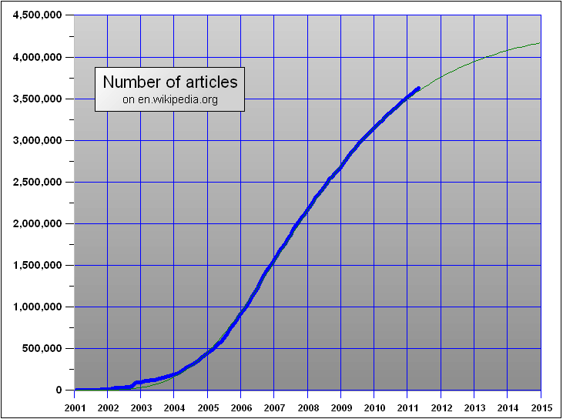
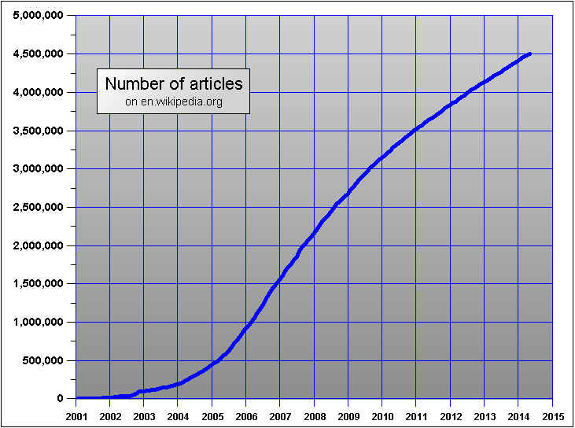
Articles on Wikipedia

Slide 23
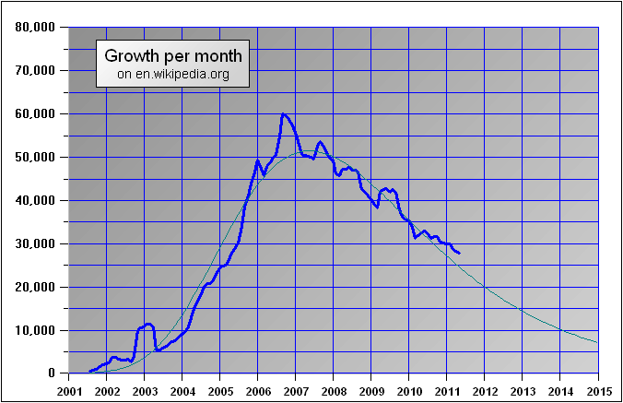
Article Growth on Wikipedia

Slide 24
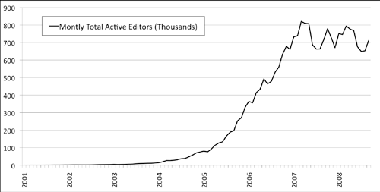
Active Editors on Wikipedia

Slide 25
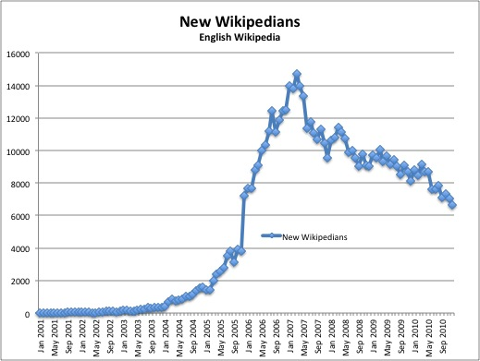
New Editors on Wikipedia

Slide 26
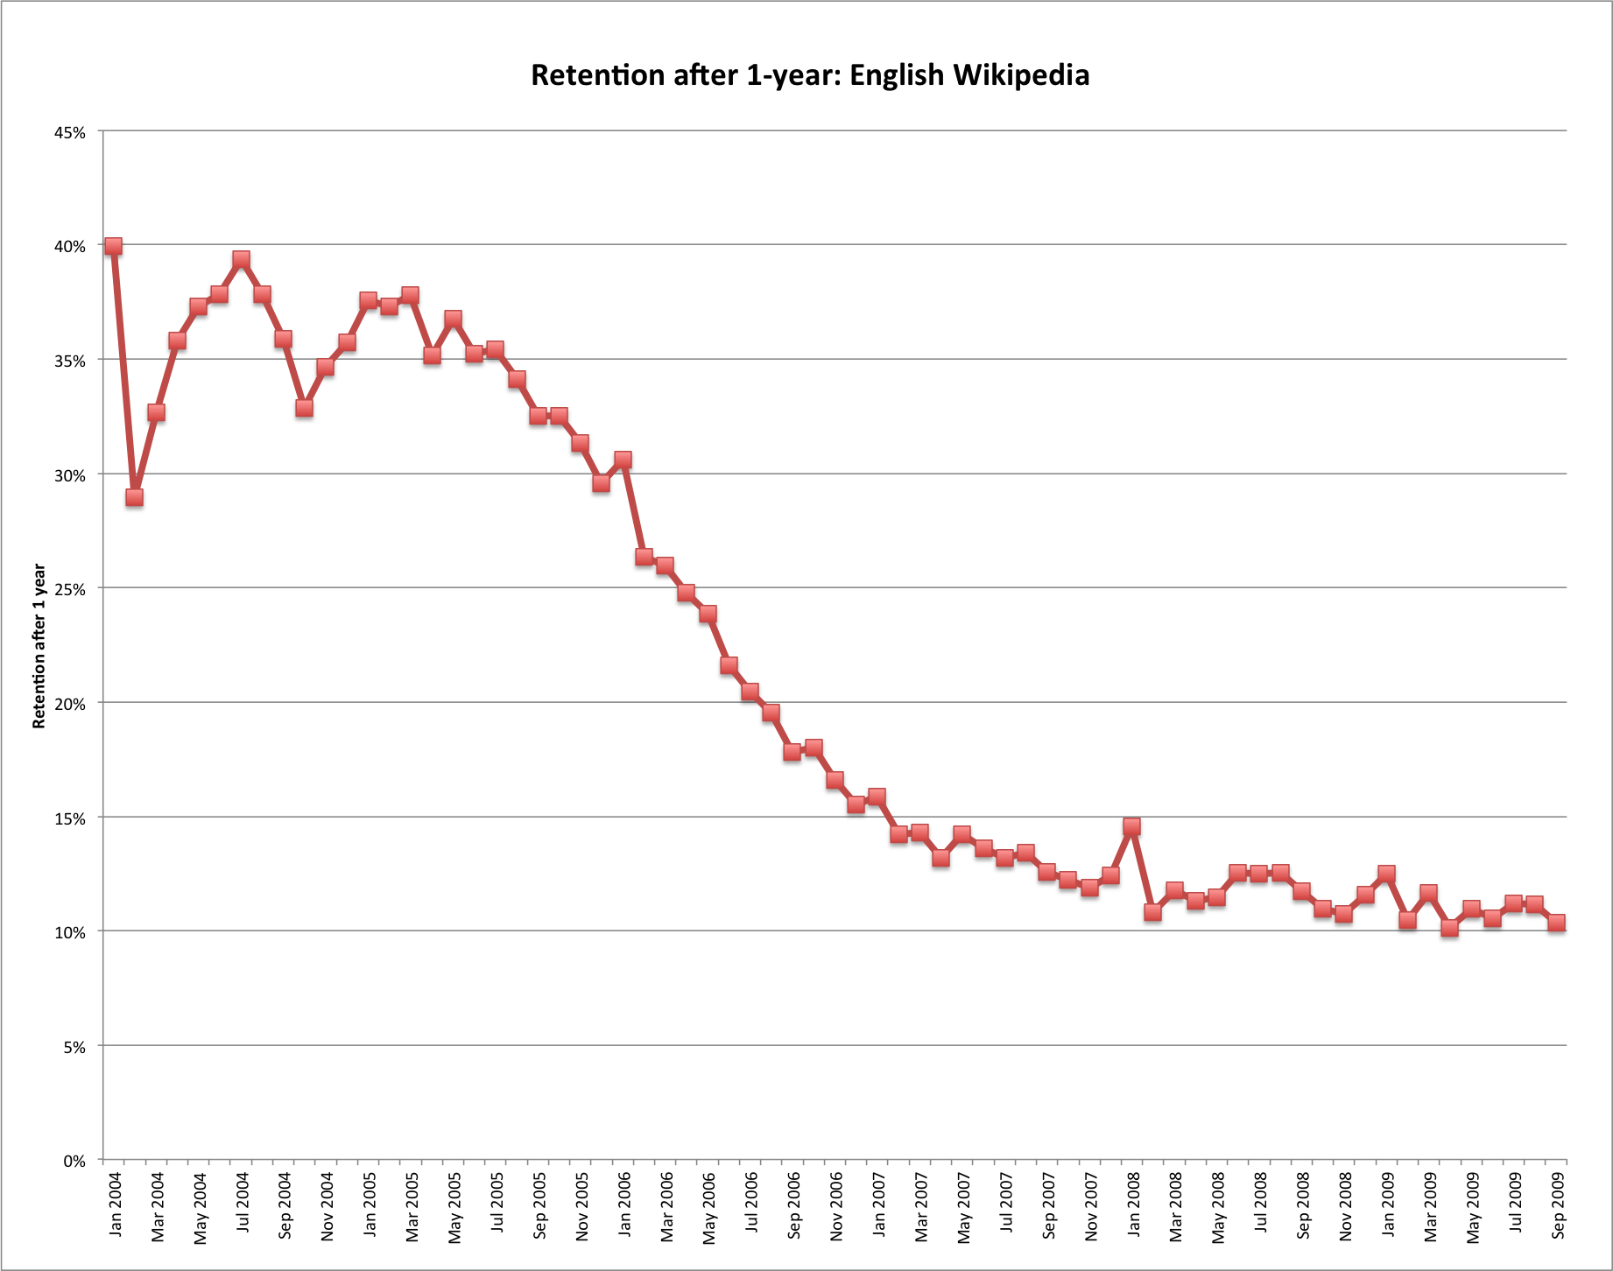
Declining Rates of Survival

Slide 27
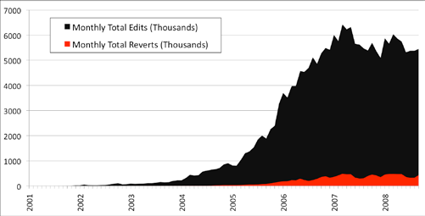
Edits and “Reverts”

Slide 28
Wikipedia
Why slowing growth (Suh et al., 2009)
  “Among various factors, our study suggests that the followings may have affected the growth of Wikipedia: (a) the growing resistance to new content especially when this is coming from occasional editors, (b) the greater overhead imposed by the costs for coordination and bureaucracy, and (c) editors are running out of easy topics.”
Why declining rates of survival: several hypotheses
  Selection: early editors were enthusiasts for online writing and editing; they adopted early and have stayed on.
  Timing: early editors arrived at a good time, when there were plenty of interesting topics to write about, and no reason to leave.
  First-mover advantage: early editors set up the rules and it is harder for late arrivals to break in.

Slide 29
Stock vs Flow Network Effects
Wikipedia: users today benefit from having good editors today, but also from having good editors in the past.
Very different from, say, newspapers where readers today benefit from having good writers today.
Won’t necessarily expect a direct relationship between number of active writers and number of active readers.

Slide 30
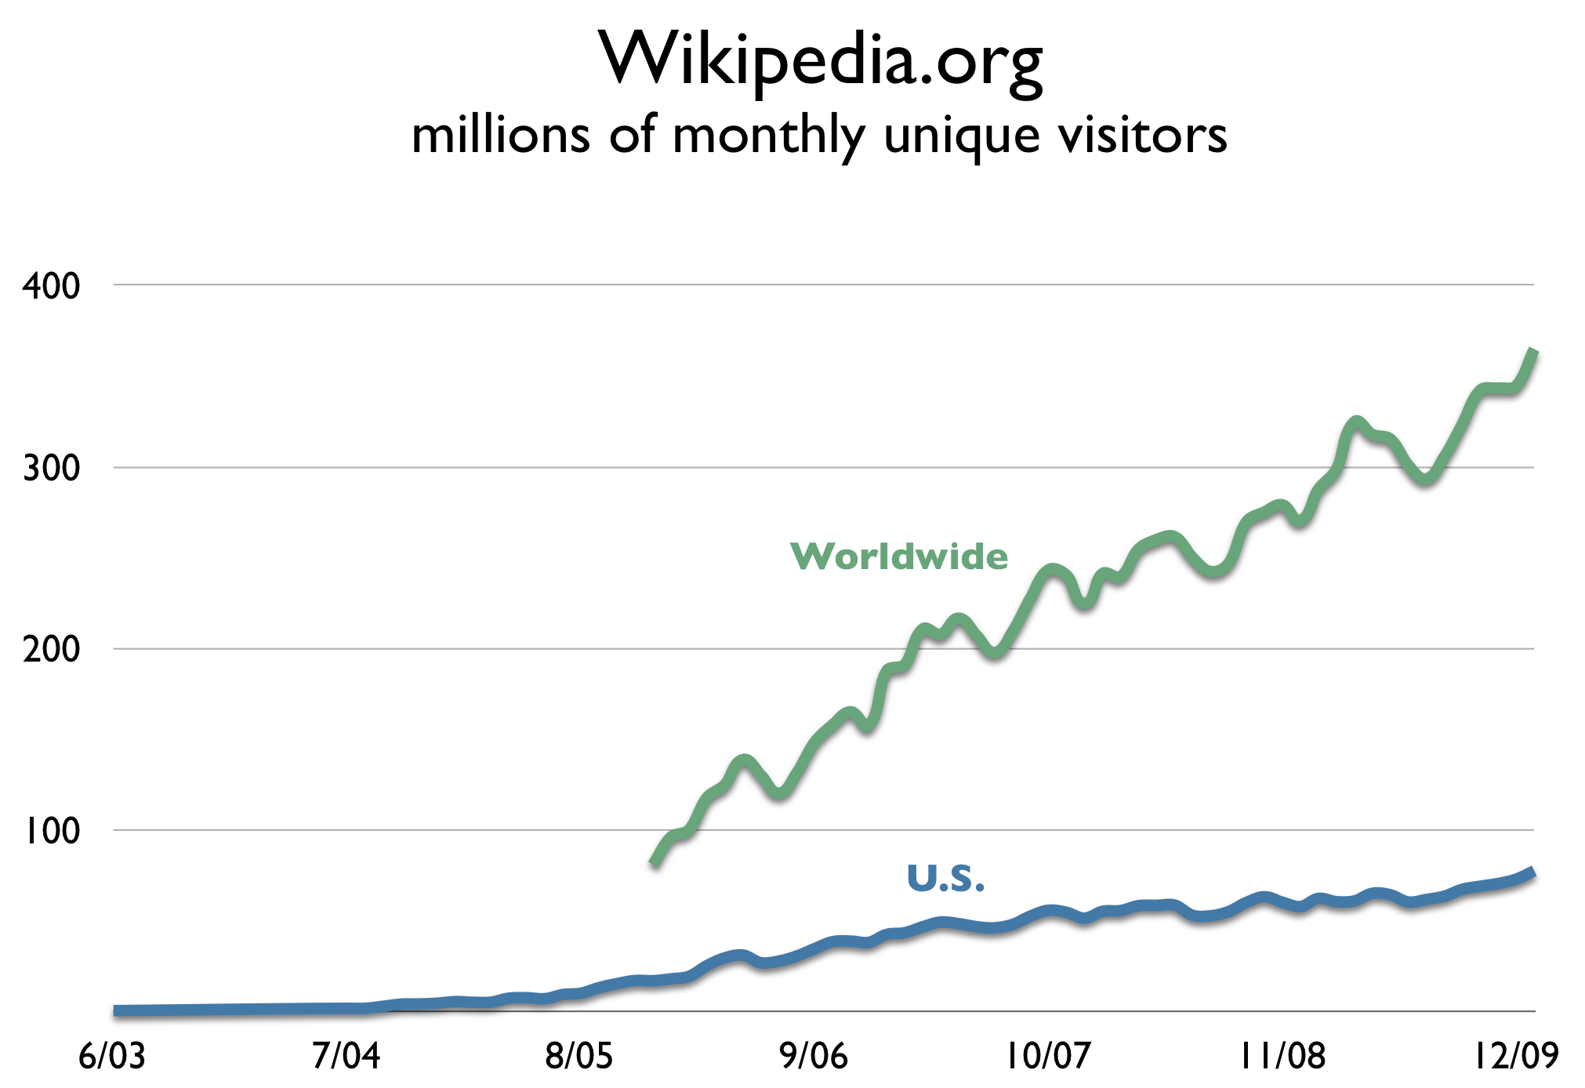
Wikipedia Readers

Slide 31
Active Sellers on eBay

Slide 32
Maturation of eBay
Typical pattern of rapid growth followed by declining entry and leveling off of activity.
Why did activity level off?
  Exhausted set of potential users (sellers)
  Site become less attractive
  External competition (from Amazon, etc.)
Pattern of seller survival and performance is remarkably similar across countries and to editor patterns on Wikipedia.

Slide 33
New Sellers on eBay

Slide 34
Survival of Sellers on eBay

Slide 35
Seller Performance on eBay
Sale probability of different eBay cohorts relative to other listings in the same quarter

Slide 36
Performance of eBay Sellers

Slide 37
Country comparisons (eBay)

Slide 38
Summary
Platform/marketplace growth and maturation often exhibits a set of empirical regularities, such as
  Rapid “snowball” adoption and subsequent maturation.
  Differences in the survival and performance of early and later cohorts of adopters (explanations perhaps less clear).
  Distinction between flow and stock interactions useful for thinking about participation of different user groups.
Platform/marketplace competition
  Dynamics of tipping are not necessarily that well understood, but some suggestive evidence.
  Entry against a dominant platform tends to be either niche, or come about indirectly or following a technological shift.

